Slide 1

HCI Usability & Accessibility Project 2025
By: Vladyslav Sharapov

Slide 2
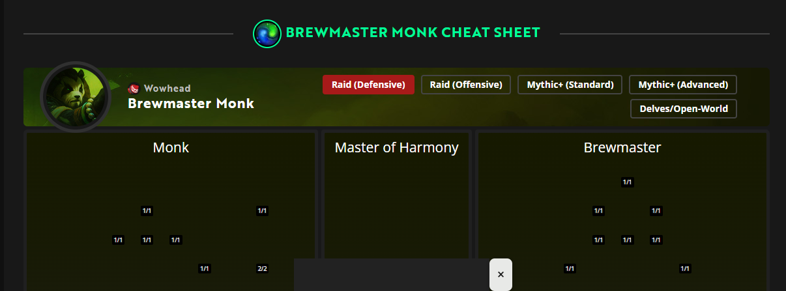
Biggest Usability Problem
These heavy pages sometimes freeze or load slowly, and the site doesn’t always show a loading indicator. This leaves the user unsure whether the page is still loading or if something wet wrong. A visible progress indicator would greatly reduce confusion

Slide 3
Biggest Accessibility Problem
Low-contrast text and missing ARIA labels make the site difficult to use for people with visual impairments or screen-reader users.

Slide 4
Thank you
Created by: Vladyslav Sharapov
ID: c00325055

